Slide 1
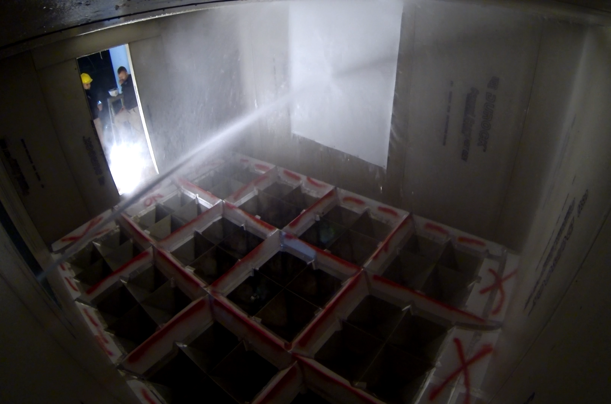
Interior
Door
Exterior Window
Test Info: Ext, SB, At Wall

Slide 2
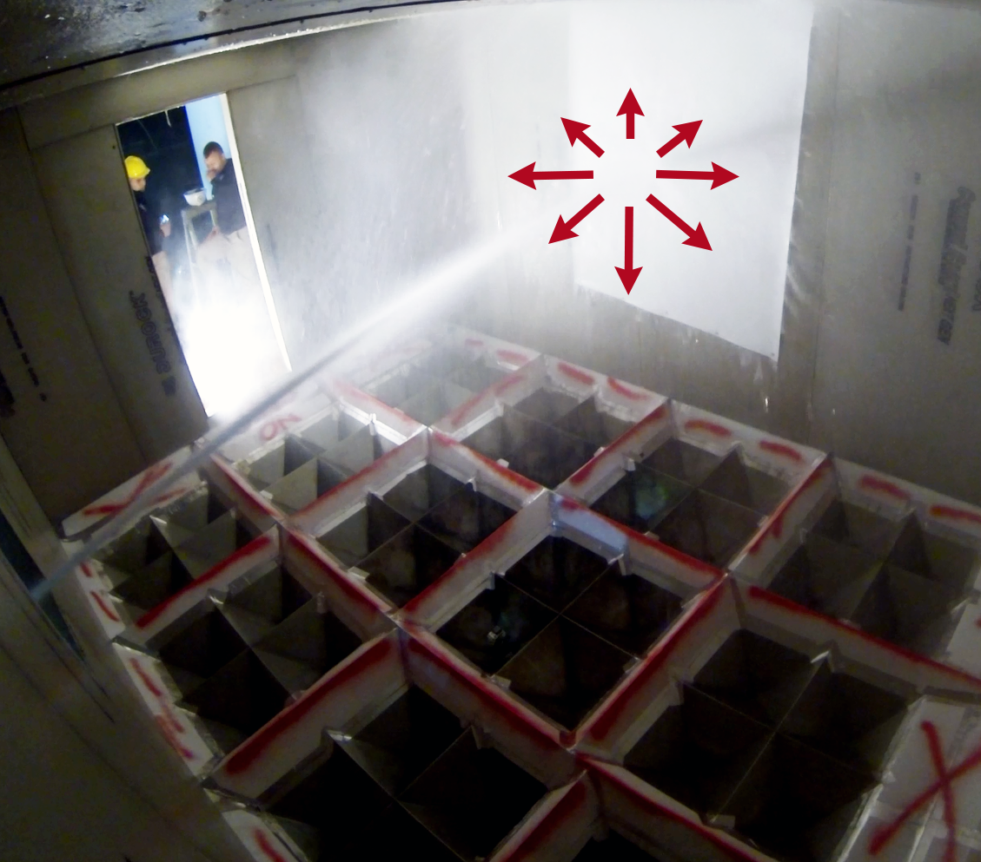
Interior
Door
Exterior Window
Test Info: Ext, SS, At Wall

Slide 3
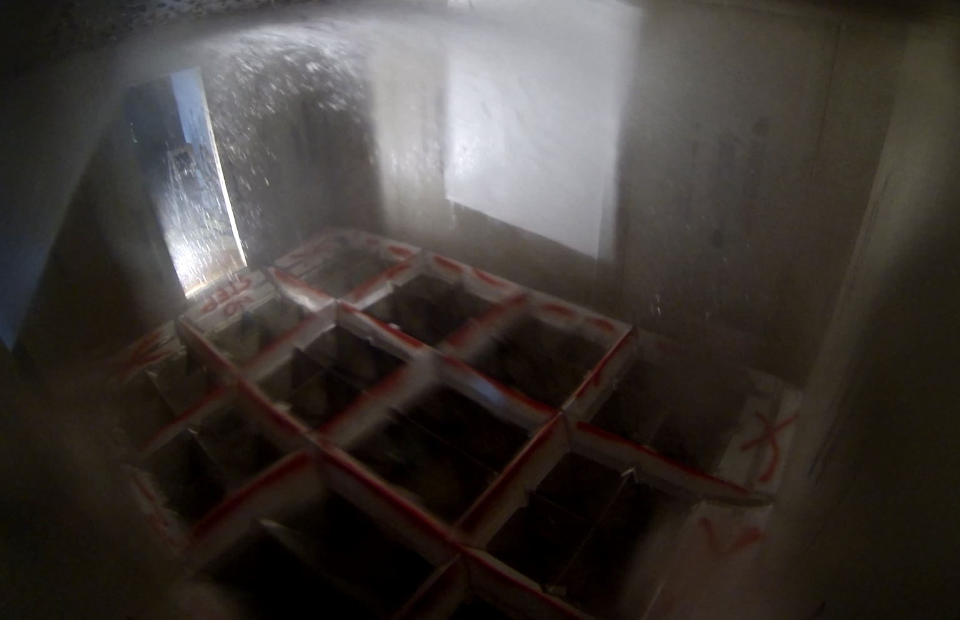
Interior
Door
Exterior
Window
Test Info: Ext, Fog, Max Angle Ceiling

Slide 4
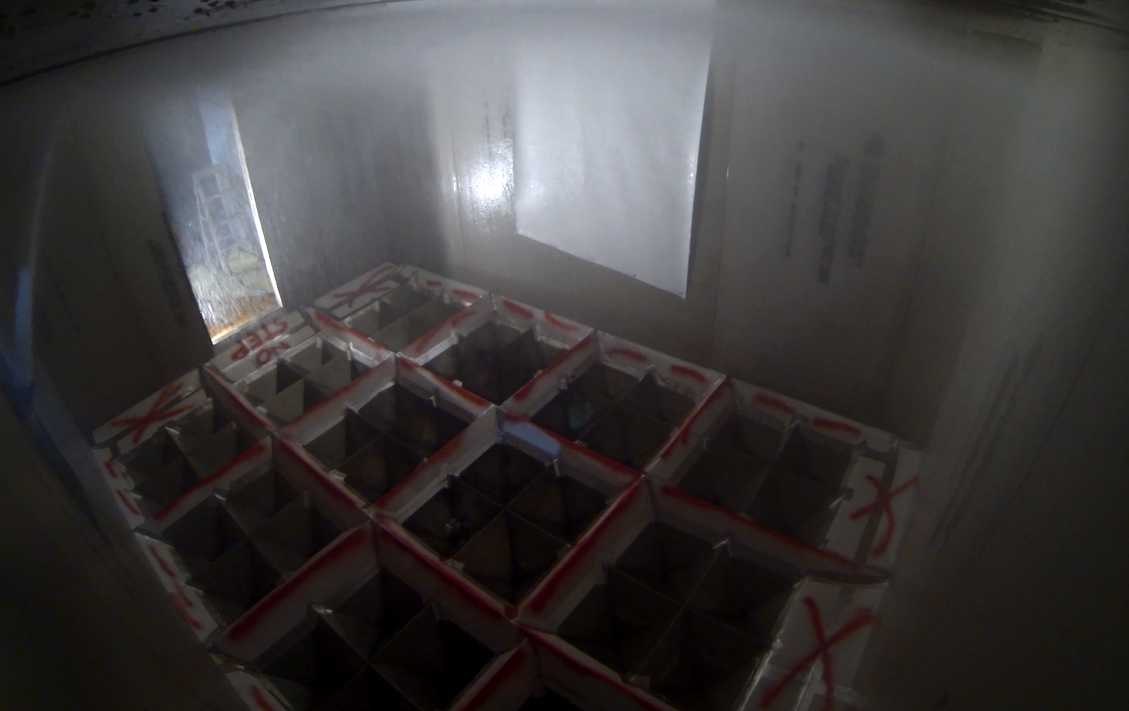
Interior
Door
Exterior
Window
Test Info: Ext, SS, Max Angle Ceiling

Slide 5
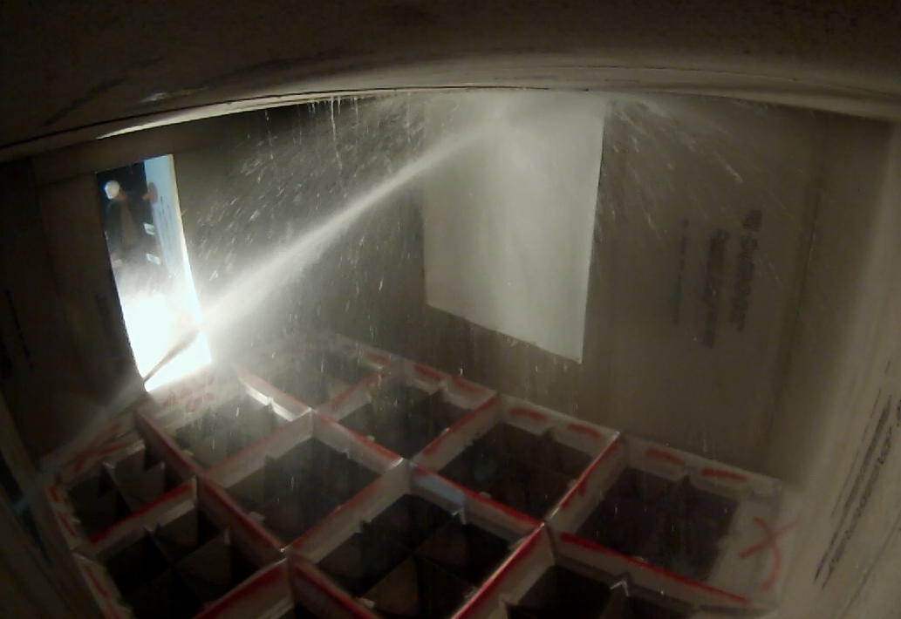
Interior
Door
Exterior
Window
Test Info: Ext, SB, Max Angle Wall

Slide 6
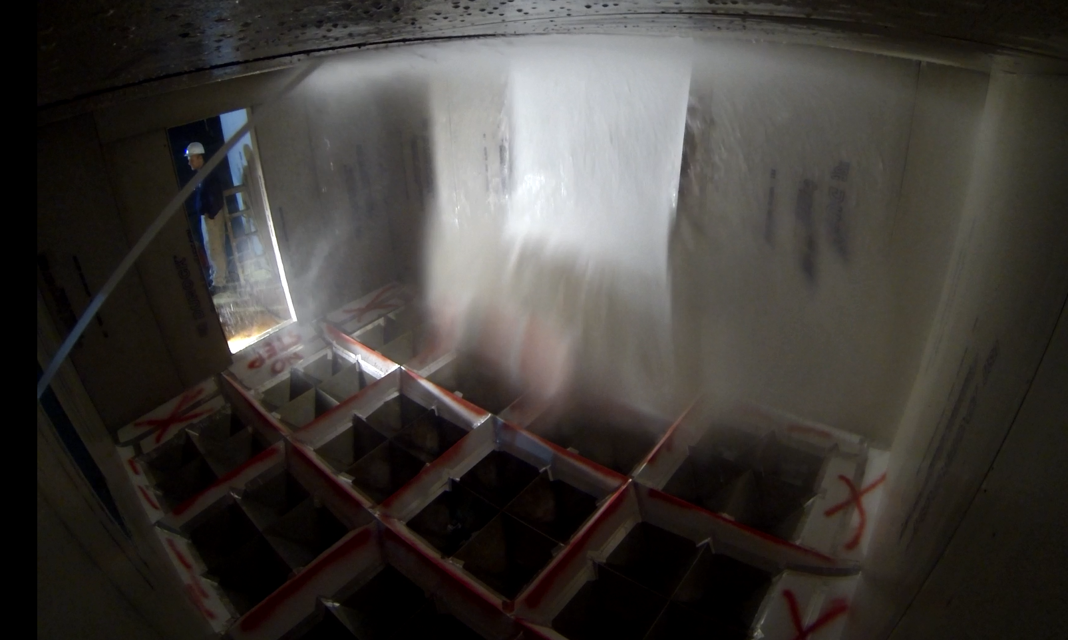
Interior
Door
Exterior
Window
Test Info: Ext, SB, Mid Ceiling

Slide 7
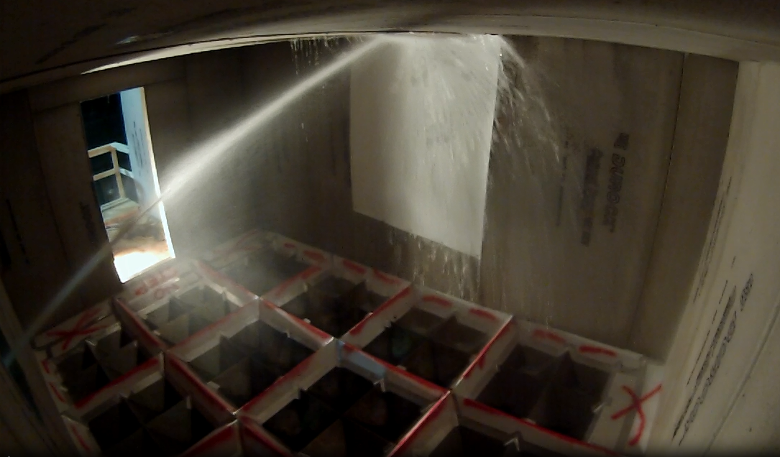
Interior
Door
Exterior
Window
Test Info: Ext, SB, Min Angle Ceiling

Slide 8
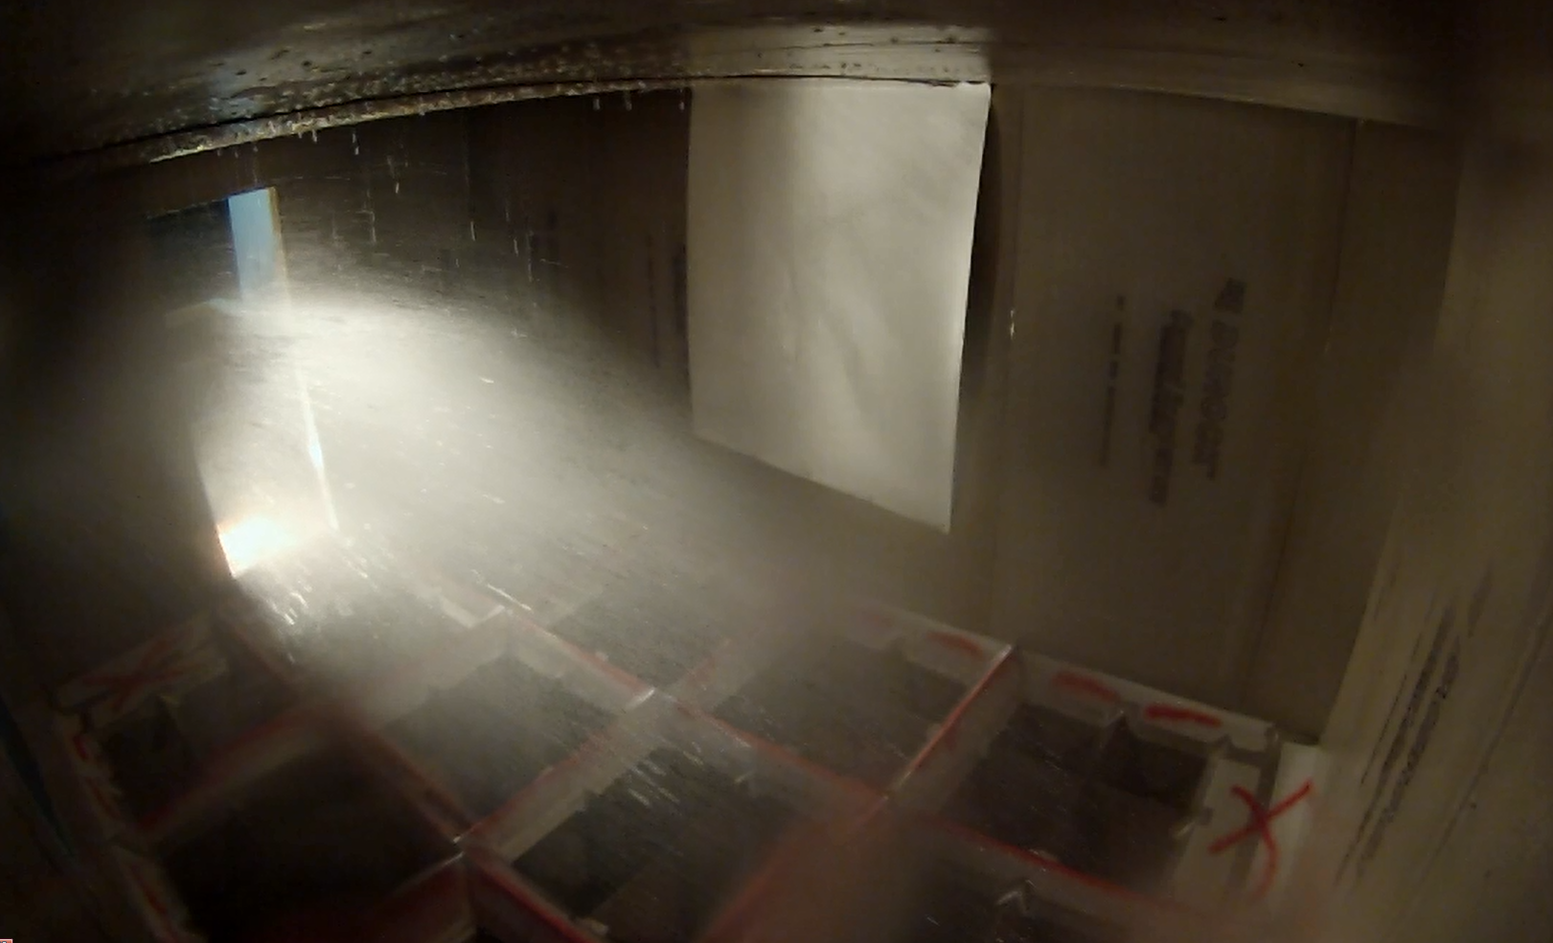
Interior
Door
Exterior
Window
Test Info: Ext, SS, Soffit

Slide 9
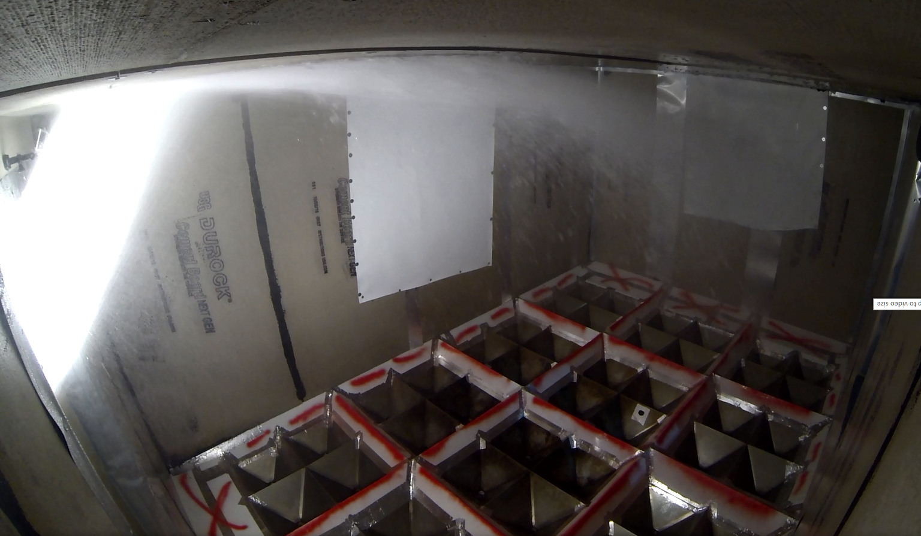
Test Info: Int, Fog, Max Angle Ceiling
Interior
Door
Exterior
Window

Slide 10
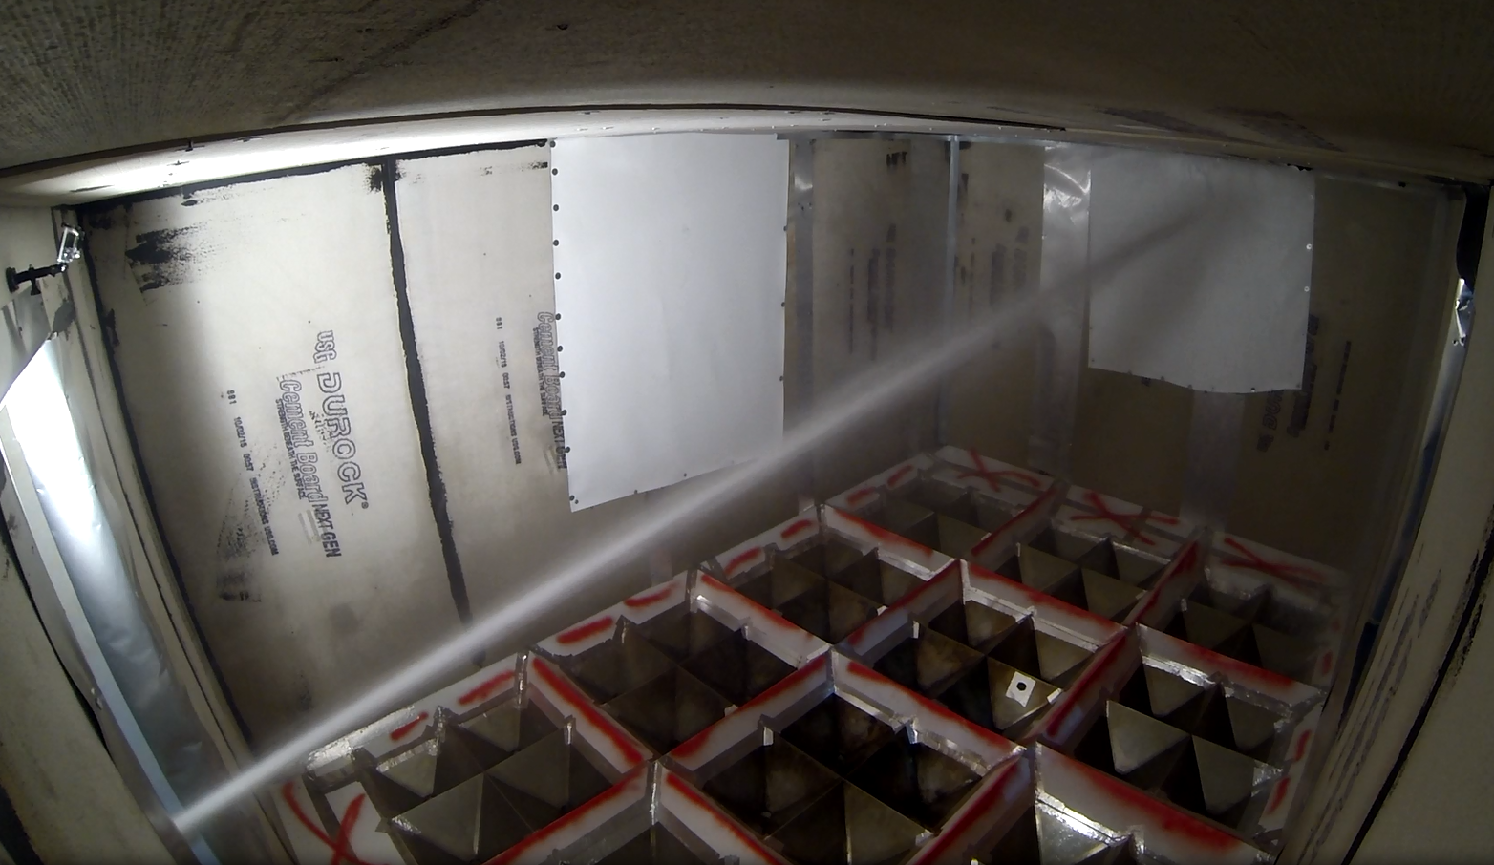
Test Info: Int, SB, Max Angle Wall
Interior
Door
Exterior
Window

Slide 11
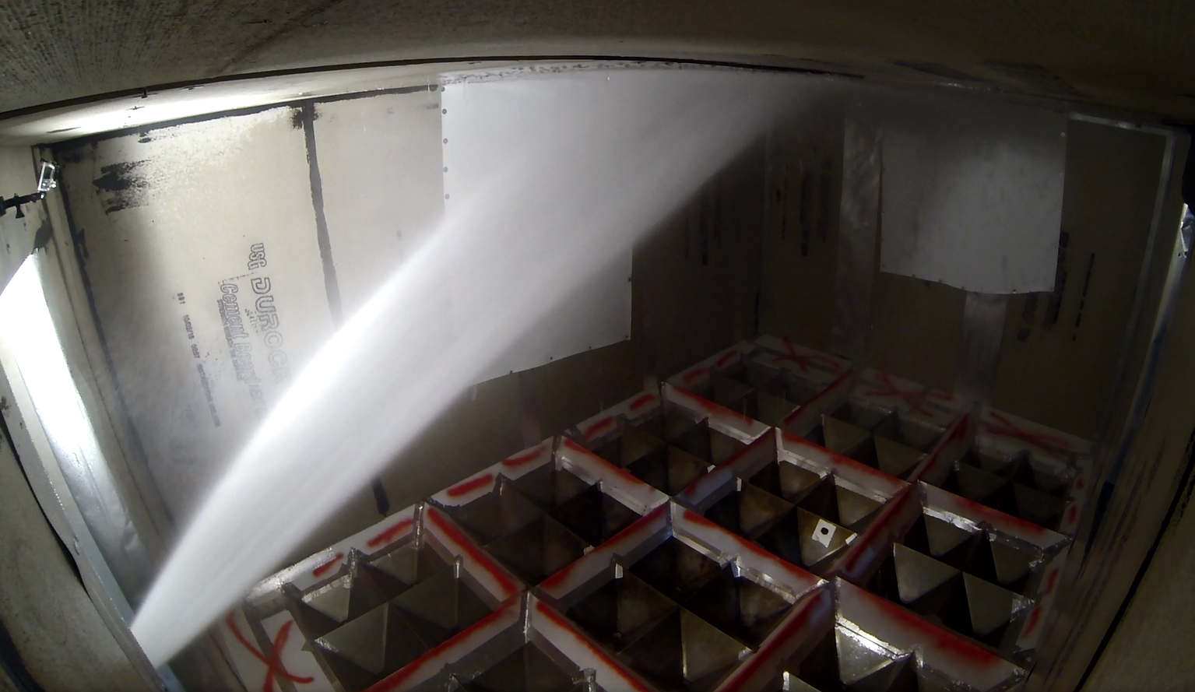
Test Info: Int, Fog, Mid Ceiling
Interior
Door
Exterior
Window

Slide 12
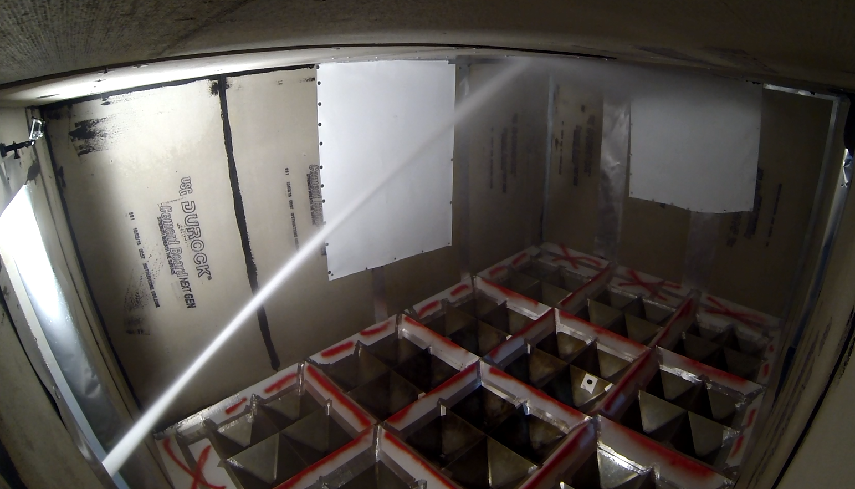
Test Info: Int, SS, Mid Ceiling
Interior
Door
Exterior
Window

Slide 13
< 0.05 gpm/ft²
6 to 9 gpm/ft²
0.05 to 3 gpm/ft²
> 9 gpm/ft²
3 to 6 gpm/ft²

